Slide 1
Contributing to openSUSE
Name goes here
Title goes here

Slide 2
Agenda
Why does openSUSE matter?
Benefits of Contributing
Ways to Contribute
  Testing
  Packaging
  Bug Fixing
  Support
  Documentation
  Translation
  Engage

Slide 3
Why does openSUSE matter?
Compilation of the 'latest and greatest' stable software available from the F/LOSS community
The Linux distribution for “Power Users” who want to get work done
  Capable as a Desktop, Server, Embedded (ARM), etc..
Upstream for SUSE Linux Enterprise
  SUSE Linux Enterprise 12 expected 2014
Notes:
SLE 11 was released March 2009, just after openSUSE 11.1

Slide 4
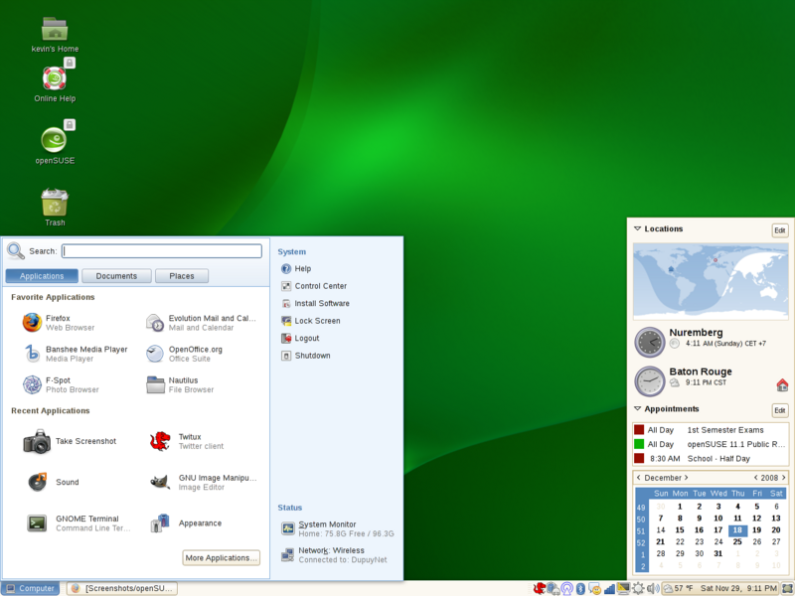
openSUSE 11.1 – released December 2008

Slide 5
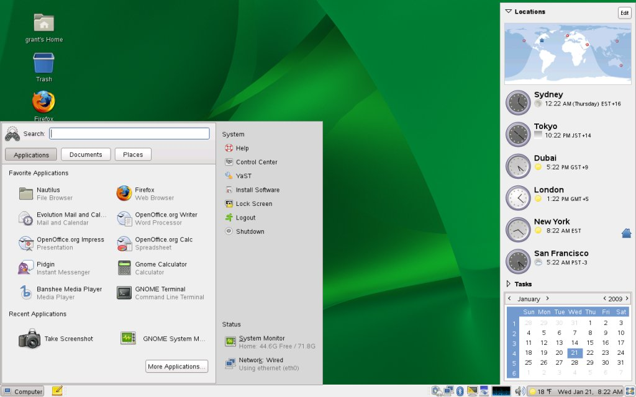
SLED 11 – released March 2009

Slide 6
Benefits of Contributing
Gain better understanding of Linux
  Learn knowledge & skills that apply to SLE
  Solve problems faster/better – Design smarter solutions
Help improve SUSE Linux Enterprise
  Even small 'polish' can find it's way to SLE – especially with SLE 12 incoming
  Controversial change more likely to be accepted if tested and proven in openSUSE first
Solve your problems/use cases
  Open Source is driven best when contributors have an “itch to scratch”
  What do you wish openSUSE/Linux could do, but doesn't? (yet)
Notes:
Learn how Linux in general and SUSE Linux in particular
See how it's put together
Insight into SUSE development processes
Help improve SLE – Contraversial changes to SLE are more likely to be accepted if already proven and working in openSUSE

Slide 7
How to Contribute

Slide 8
Testing – Bug Reporting
openSUSE uses Novell Bugzilla
  http://bugzilla.novell.com
  Use your Novell Customer Centre credentials
Detailed step-by-step guide & Documentation
  https://en.opensuse.org/openSUSE:Submitting_bug_reports
  Use links to report for each version – much simpler than default bugzilla

Slide 9
Testing – Factory
Main development happens in openSUSE:Factory
  Repositories http://download.opensuse.org/factory/repo/
  Install ISO's http://download.opensuse.org/factory/iso/
  Upgrade/Install, test, report bugs
  Beta/RC - snapshots of Factory
Discuss major/architectural issues
  Don't let them sit in Bugzilla
  Mailing list – opensuse-factory@opensuse.org
  IRC - #openSUSE-factory on irc.opensuse.org (Freenode)

Slide 10
Testing – Devel Projects
Before entering Factory, all packages are built/tested in a 'devel project'
  https://en.opensuse.org/openSUSE:Factory_development_model
Base System
  http://download.opensuse.org/repositories/Base:/System/
GNOME
  http://download.opensuse.org/repositories/GNOME:/Factory/openSUSE_Factory/
PHP
  http://download.opensuse.org/repositories/devel:/languages:/php:/php54/
Notes:
Devel repos are often built for older /still stupported versions – good source of backports

Slide 11
Packaging
You have/know of THE Killer Linux App/version
It's not in openSUSE
  Check http://software.opensuse.org to be sure
Now what?

Slide 12
Packaging – Workflow
Write/get source code
Write/modify 'spec' file
  Provides metadata about the software & how it needs to be packaged
  Template often included with many source projects
Write/modify change log
  Users need to know what they're getting and why
**Magic Happens**
Submit Package

Slide 13
“The Magic” aka Open Build Service
OBS – The 'secret weapon' of the openSUSE distribution
  Stores all sources in a revision control system
  Stores all binaries
  Calculates the need for rebuilds and triggers them automatically
  Acts as a database for all packaging related queries
Client tools
  osc CLI
    Best way to handle sources
    Can do local builds
  Web UI
    Best way to monitor progress/browse other packages
    Monitor/Manage requests

Slide 14

Open Build Service – Getting started
http://build.opensuse.org
  Login with Novell Customer Centre Login
  Create your home project
  Get packaging
Further reading
https://en.opensuse.org/openSUSE:Build_Service_Tutorial
https://en.opensuse.org/openSUSE:How_to_contribute_to_Factoryhttps://en.opensuse.org/Portal:Packaging
Need Help?
  #opensuse-buildservice on irc.opensuse.org
  opensuse-buildservice@opensuse.org
  opensuse-packaging@opensuse.org

Slide 15
Bug Fixing
Find bugs you can/want to fix
Search links on https://en.opensuse.org/openSUSE:Submitting_bug_reports
User Watching https://bugzilla.novell.com/userprefs.cgi?tab=email
  GNOME – bnc-team-gnome@forge.provo.novell.com
  KDE – kde-maintainers@suse.de
  Kernel – kernel-maintainers@forge.provo.novell.com

Slide 16
Bug Fixing – Finding the fix
Many bugs are already fixed by “Upstream”
http://www.google.com
  “<package/project name> source”
  “<package/project name> commit log”
  “<package/project name> git”
Find changes that fix the issue
  Is it a simple simple patch?
  Does it require a version change?

Slide 17
Bug Fixing – Factory
Fixing a bug in Factory
Find the fix - Often in new version of Package
Solution – Package New Version
Submit to Devel Repository
  https://en.opensuse.org/openSUSE:How_to_contribute_to_Factory

Slide 18
Bug Fixing – Released Versions
Fixing a bug in released versions
Find the fix - Often in new version of Package
Can the solution be packaged as a small patch?
  https://en.opensuse.org/openSUSE:Maintenance_policy
Propose patch in Bugzilla
Update bug with NEEDINFO from maintenance@opensuse.org
  Security bugs – NEEDINFO from security-team@suse.de
Add patch to package
Submit to Update Repository
https://en.opensuse.org/Portal:Maintenance

Slide 19
Support
We have users that need YOUR help
Forum – http://forums.opensuse.org
IRC - #opensuse on irc.opensuse.org
Mailing Lists – opensuse@opensuse.org
  International see http://lists.opensuse.org
Google+ - Communities > openSUSE

Slide 20
Documentation
ActiveDoc
A new way of compiling SUSE/openSUSE documentation
http://activedoc.opensuse.org/
https://en.opensuse.org/openSUSE:Documentation_Contribute
#opensuse-doc on irc.opensuse.org
opensuse-doc@opensuse.org

Slide 21
Translation
Speak another language? openSUSE needs your help translating YaST, applets, menus, documentation, etc
http://i18n.opensuse.org/
https://en.opensuse.org/OpenSUSE_Localization_Guide
Speak German? You can help our friends at LibreOffice
https://wiki.documentfoundation.org/Development/Easy_Hacks/Translation_Of_Comments

Slide 22
Engage
Like openSUSE? Tell People!
  How are you using it? Tell opensuse-marketing@opensuse.org
  Write a blog? Get syndicated on http://planet.opensuse.org
  We want more openSUSE sessions at conferences
    FOSDEM, TTP, Brainshare, OSCON, LinuxCon, LinuxTag, SCALE etc
Don't like openSUSE? Don't just tell us, help us make it better
  Mailing Lists – http://lists.opensuse.org
  IRC – everything #opensuse-* on irc.opensuse.org

